Slide 1
E-commerce Customer Spending Prediction

Slide 2
Problem Statement
A project with an Ecommerce company sells clothing online but they also have in-store style and clothing advice sessions. Customers come in to the store, have sessions/meetings with a personal stylist, then they can go home and order either on a mobile app or website for the clothes they want. The company is trying to decide whether to focus their efforts on their mobile app experience or their website. They have asked to help them figure it out.
A fitness company offers both in-person training sessions at their gyms and online workout programs through their mobile app and website. Customers can visit the gym for personal training sessions, then choose to continue their fitness journey by accessing workout plans, tracking progress, and purchasing supplements either through the mobile app or the website. The company wants to determine whether they should prioritize enhancing their mobile app experience or improving their website to better serve their customers. They have asked for help in making this decision.

Slide 3
Dataset Overview
Dataset Overview:
We are working with the Ecommerce Customers CSV file, which includes:
Customer Information: Email, Address, Color Avatar (not used for numerical analysis).
Numerical Features:
Avg. Session Length: Average time spent in in-store style advice sessions (minutes).
Time on App: Average time spent on the mobile app (minutes).
Time on Website: Average time spent on the website (minutes).
Length of Membership: How many years the customer has been a member.
Yearly Amount Spent: Total annual spending by the customer ($).
Business Objective:
Identify which factors influence Yearly Amount Spent the most.
Determine whether customers using the mobile app or website contribute more to revenue.
Build a predictive model for customer spending.
Deploy the model using Streamlit for real-time predictions.

Slide 4
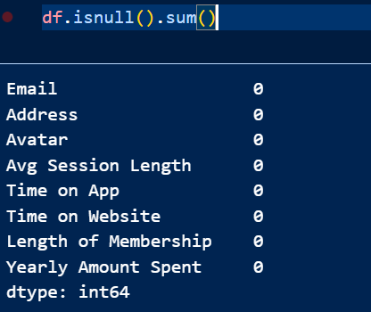
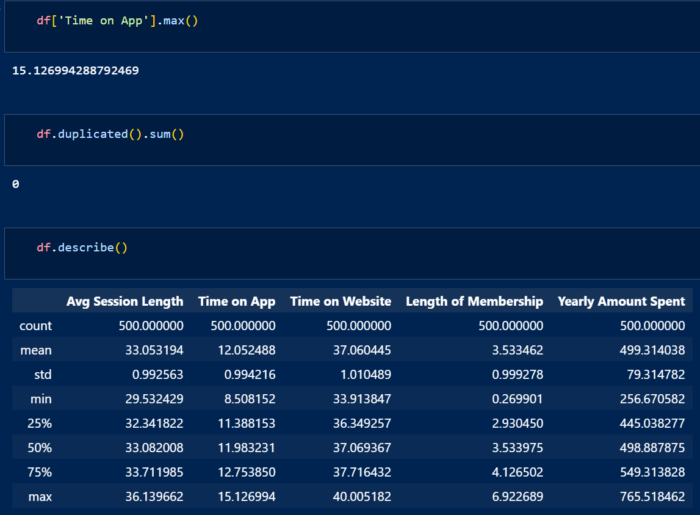
Exploratory Data Analysis (EDA)
1. Data Quality Check
No missing values: Every column has 500 non-null values, meaning the dataset is complete.
No duplicate records: df.duplicated().sum() returned 0, ensuring data integrity.
Data types:
There are 3 object (categorical) columns: Email, Address, Avatar (not useful for prediction).
The remaining 5 columns are numerical (float64), which are suitable for regression analysis.
2. Summary Statistics
Time on App vs. Time on Website:
Customers spend more time on the Website (mean ≈ 37.06 mins) than on the App (mean ≈ 12.05 mins).
Max Time on App: 15.13 mins (lower than Website’s max of 40.00 mins).
Suggests customers use the website more than the app.
Avg. Session Length:
Ranges from 29.53 to 36.14 minutes, with a mean of 33.05 minutes.
Indicates how long customers spend in in-store style advice sessions.
Length of Membership:
Varies from 0.27 to 6.92 years, with an average of 3.53 years.
More experienced members may have higher spending.
Yearly Amount Spent (Target Variable):
Ranges from $256.67 to $765.52, with an average of $499.31.
Higher spending customers might be influenced by certain factors (e.g., app usage, membership length).

Slide 5
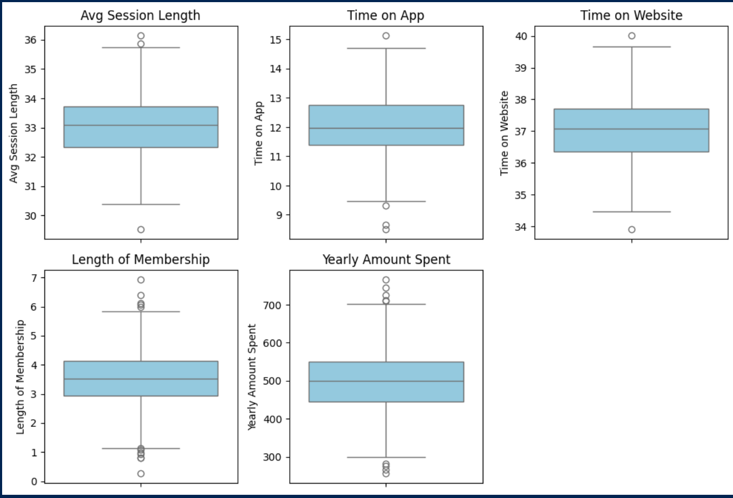
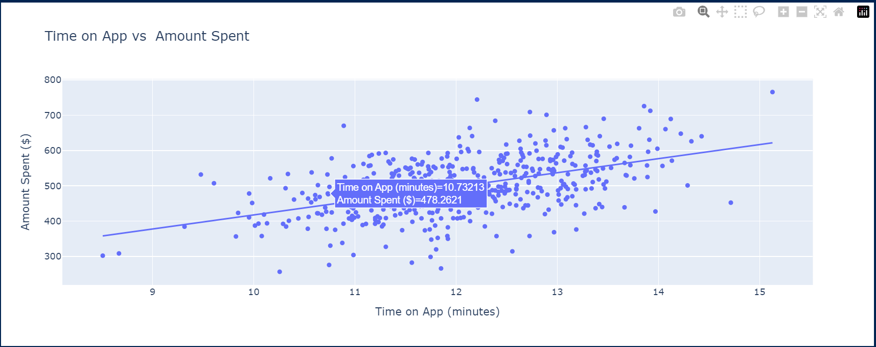
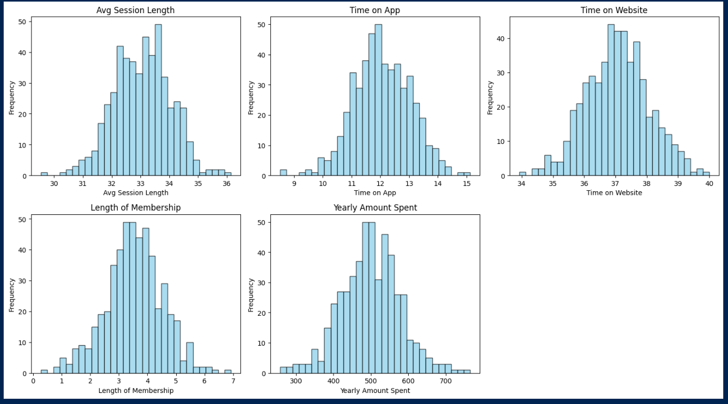
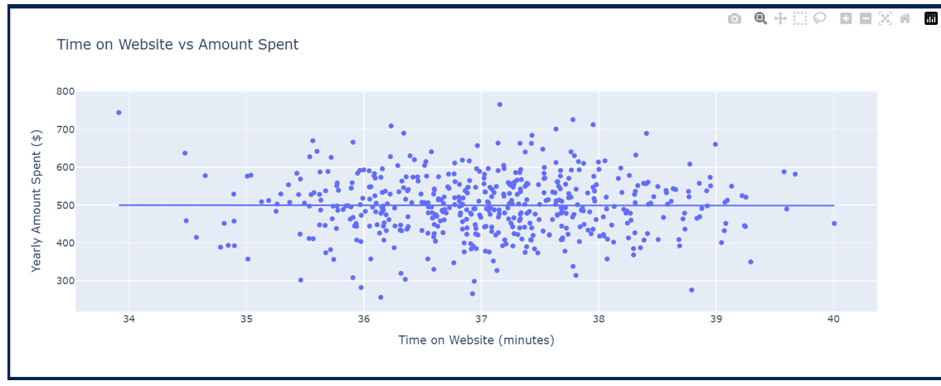
visualizations

Slide 6
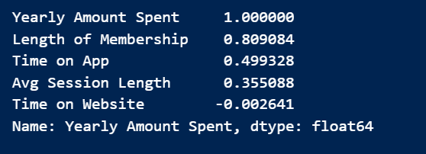
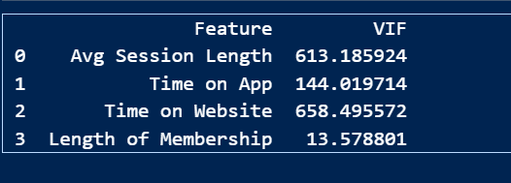
Feature Selection
Length of Membership (Strongest correlation: 0.809)
Time on App (Moderate correlation: 0.499, but high VIF)
Time on Website (Negligible correlation: -0.002, very high VIF: 658.49)
Avg Session Length (Moderate correlation: 0.355, but extremely high VIF: 613.18)
Reasoning:
Multicollinearity Issue: Time on Website & Avg Session Length have high VIF, meaning they may cause redundancy.
Correlation with Target: Length of Membership is the strongest predictor of yearly spending.
Standardization Applied: Features have been scaled for better model performance.

Slide 7
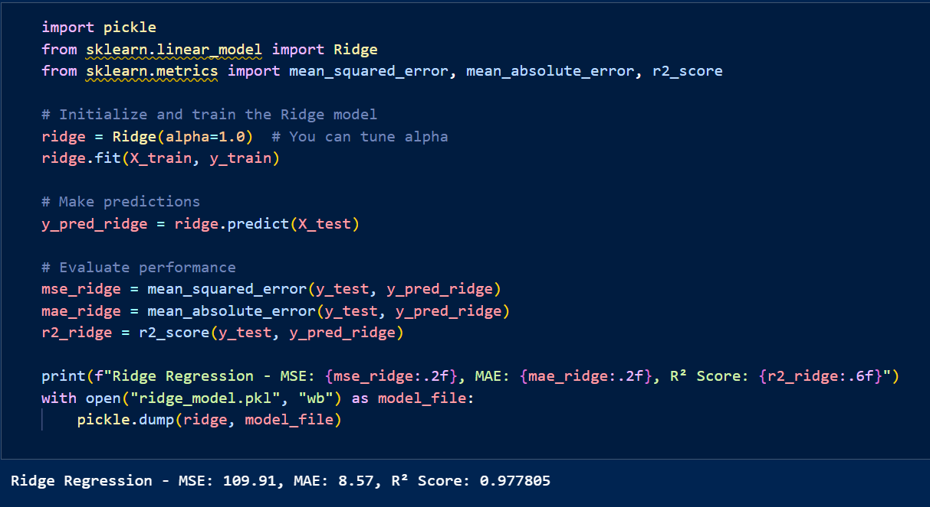
Model Building & Selection
Ridge Regression model performed well with:
MSE: 109.91
MAE: 8.57
R² Score: 0.978
Observations & Suggestions
High R² Score: Indicates a good fit. The model explains ~97.8% of the variance.
Error Values: MSE and MAE suggest the predictions are quite accurate.
Feature Selection Impact: Dropping Time on Website improved performance by reducing multicollinearity.

Slide 8
Deployment Using Streamlit
Streamlit application is designed to predict a customer's yearly spending based on their behavior patterns in an e-commerce setting. It utilizes a Ridge Regression model, which is loaded from a pre-trained ridge_model.pkl file, while the historical customer data is sourced from Ecommerce_Customers.csv. The user interface includes input fields for key customer attributes such as Length of Membership, Time on App, and Average Session Length, allowing users to enter relevant values for prediction. Upon submission, the model processes these inputs and provides an estimated yearly spending amount, which is displayed in a visually appealing prediction box. Additionally, the app includes interactive data visualizations such as feature distributions, correlation heatmaps, and scatter plots to help users understand key trends in customer behavior. It also offers a CSV download feature, enabling users to save the predicted customer profile for further analysis. Custom styling is incorporated to enhance readability, ensuring a seamless and engaging user experience.

Slide 9
Conclusion & Recommendations
The Streamlit application successfully predicts a customer's yearly spending in an e-commerce setting using a Ridge Regression model. With an R² score of 0.978, the model demonstrates a strong ability to explain variance in customer spending behavior, indicating high predictive accuracy. The low Mean Squared Error (MSE) of 109.91 and Mean Absolute Error (MAE) of 8.57 further confirm that the model provides reliable predictions. Through feature selection, removing "Time on Website" helped improve performance by mitigating multicollinearity, ensuring more stable and accurate results. Additionally, the application enhances user experience with interactive data visualizations, a CSV download option, and a well-structured interface for inputting key customer attributes. Overall, the project effectively leverages machine learning to provide valuable insights into customer spending patterns, supporting data-driven decision-making for e-commerce businesses. Future improvements could explore additional features, alternative regression techniques, and real-time data integration to further refine predictions.

Slide 10
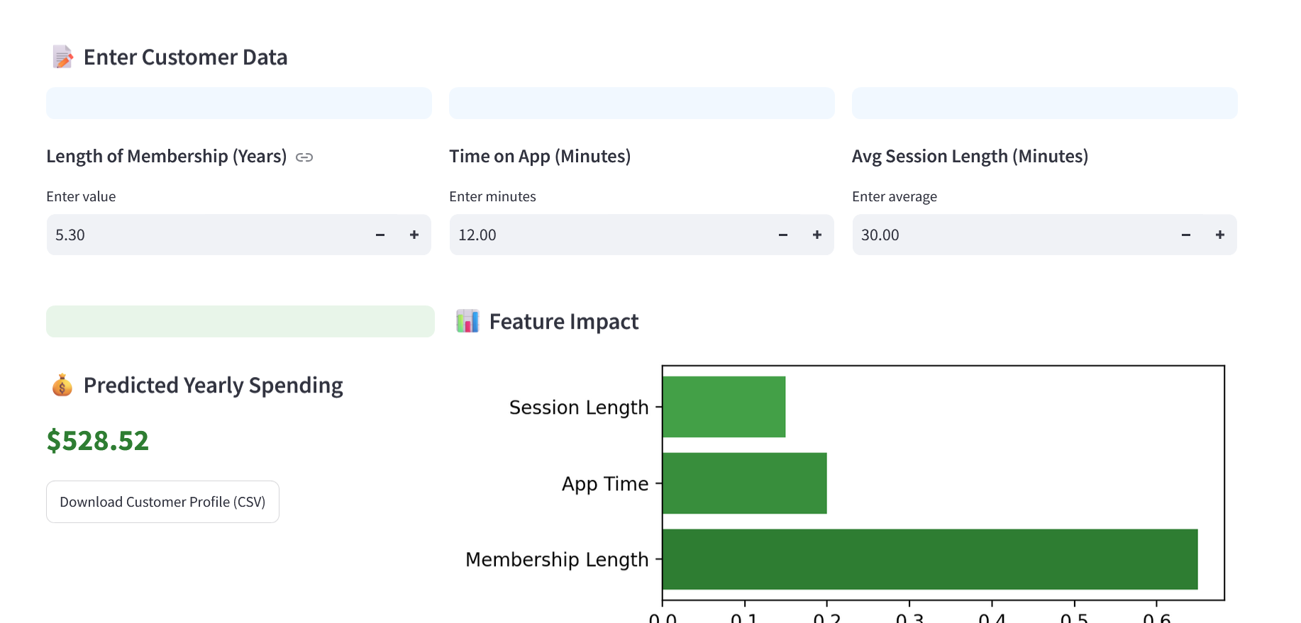
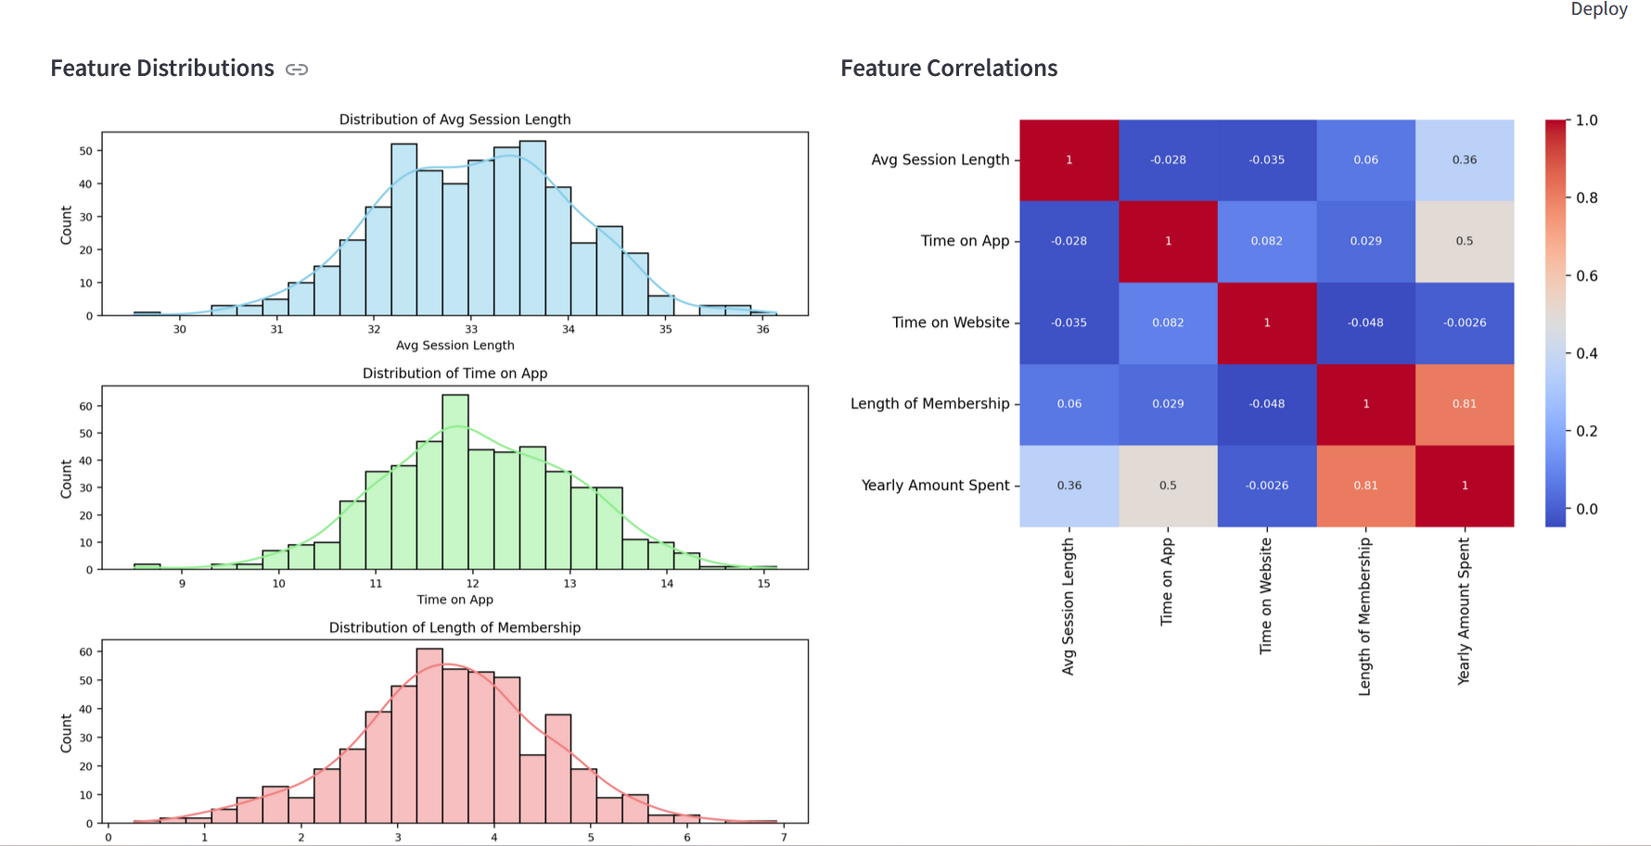

Slide 11
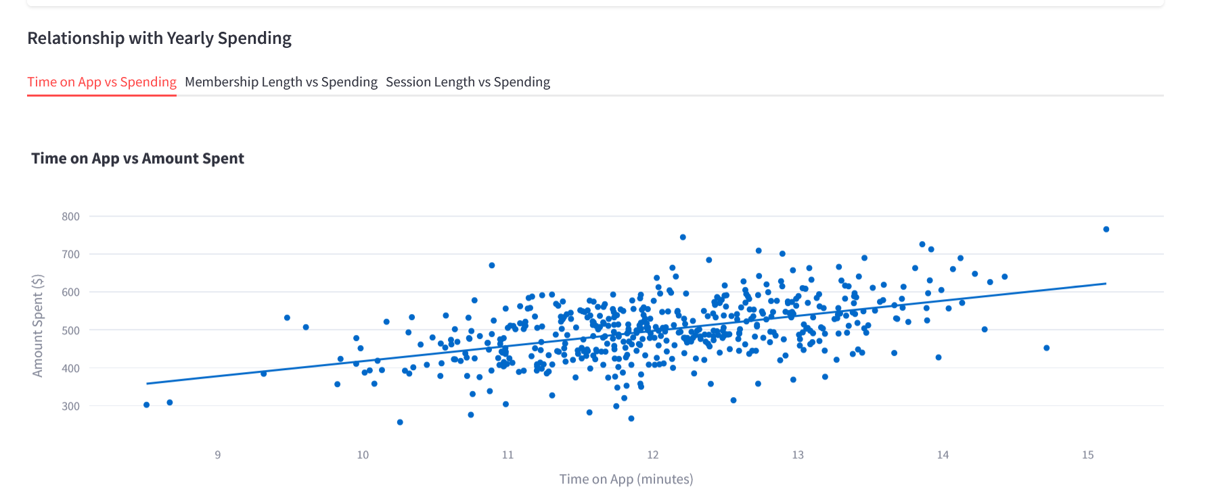

Slide 12
Project By
Dhevesh Arun
Abhiram P
Mohammed Shyjil
Ms. Teena Suresh Bokde
Sadu Gopi Krishna
Abhijit Namdeo Sangale
Harmeek Singh Saini

